Slide 1
ASCENT DR-TB COMMUNITY & CIVIL SOCIETY ENGAGEMENT (CCSE) PROGRAM
www.treatmentactiongroup.org
LINDSAY MCKENNA, MPH
TREATMENT ACTION GROUP
REGIONAL WORKSHOP, TANZANIA
JULY 2024

Slide 2
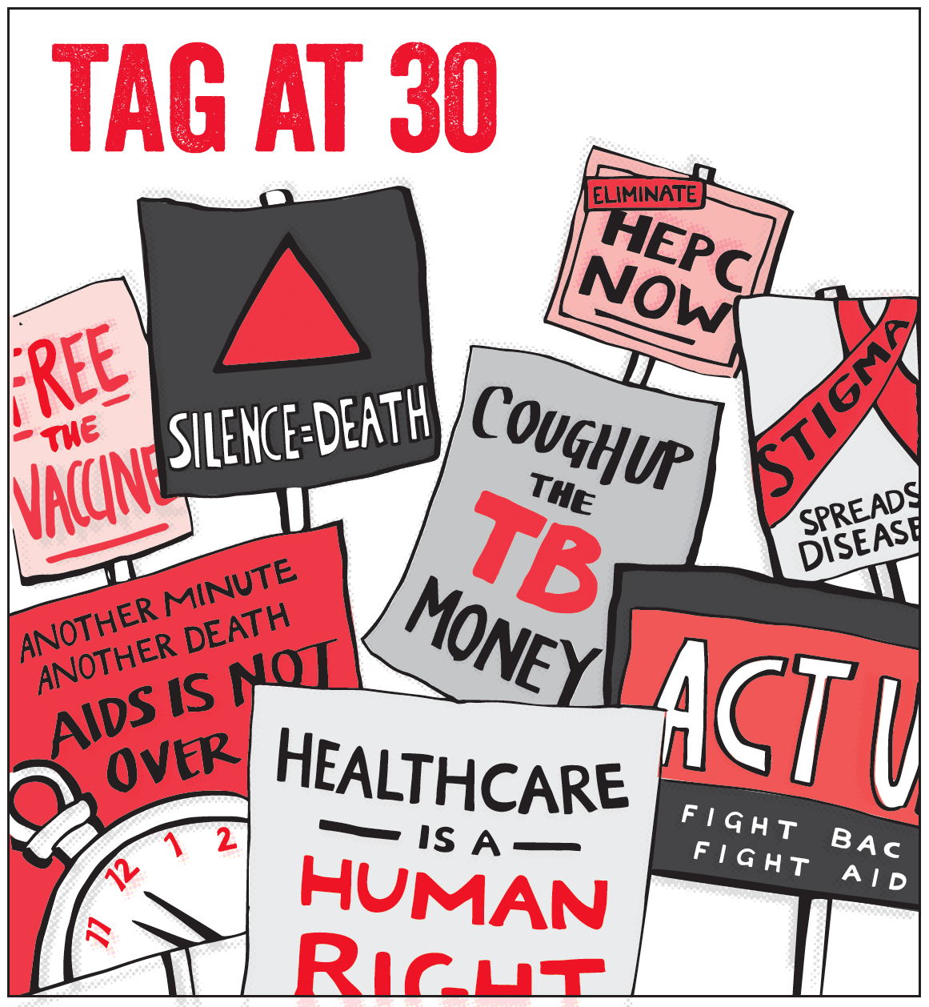
TREATMENT ACTION GROUP
Since 1992, Treatment Action Group (TAG) has been advocating to ensure people living with HIV can benefit from groundbreaking medical science. In 2002 and 2003, TAG expanded its mission to include tuberculosis (TB) and hepatitis C (HCV), respectively – leading causes of morbidity and mortality in PLHIV.
TAG catalyzes open collective action by affected communities, scientists, and policymakers to ensure that all people living with or impacted by HIV, TB, or HCV — especially communities of color and other marginalized communities experiencing inequities — receive life-saving prevention, diagnosis, treatment, care, and information.
We are science-based activists working to expand and accelerate vital research and effective community engagement with research and policy institutions for an end to HIV, TB, and HCV.
https://www.treatmentactiongroup.org/resources/tagline/tagline-november-2022/

Slide 3
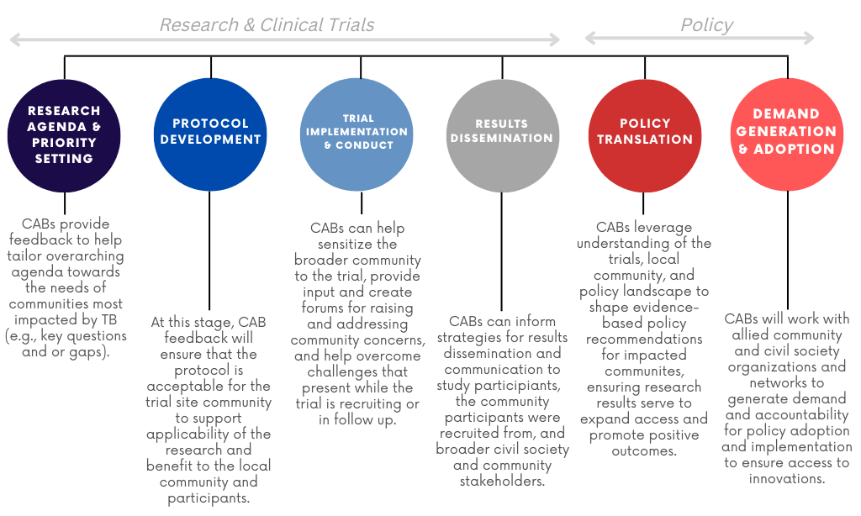
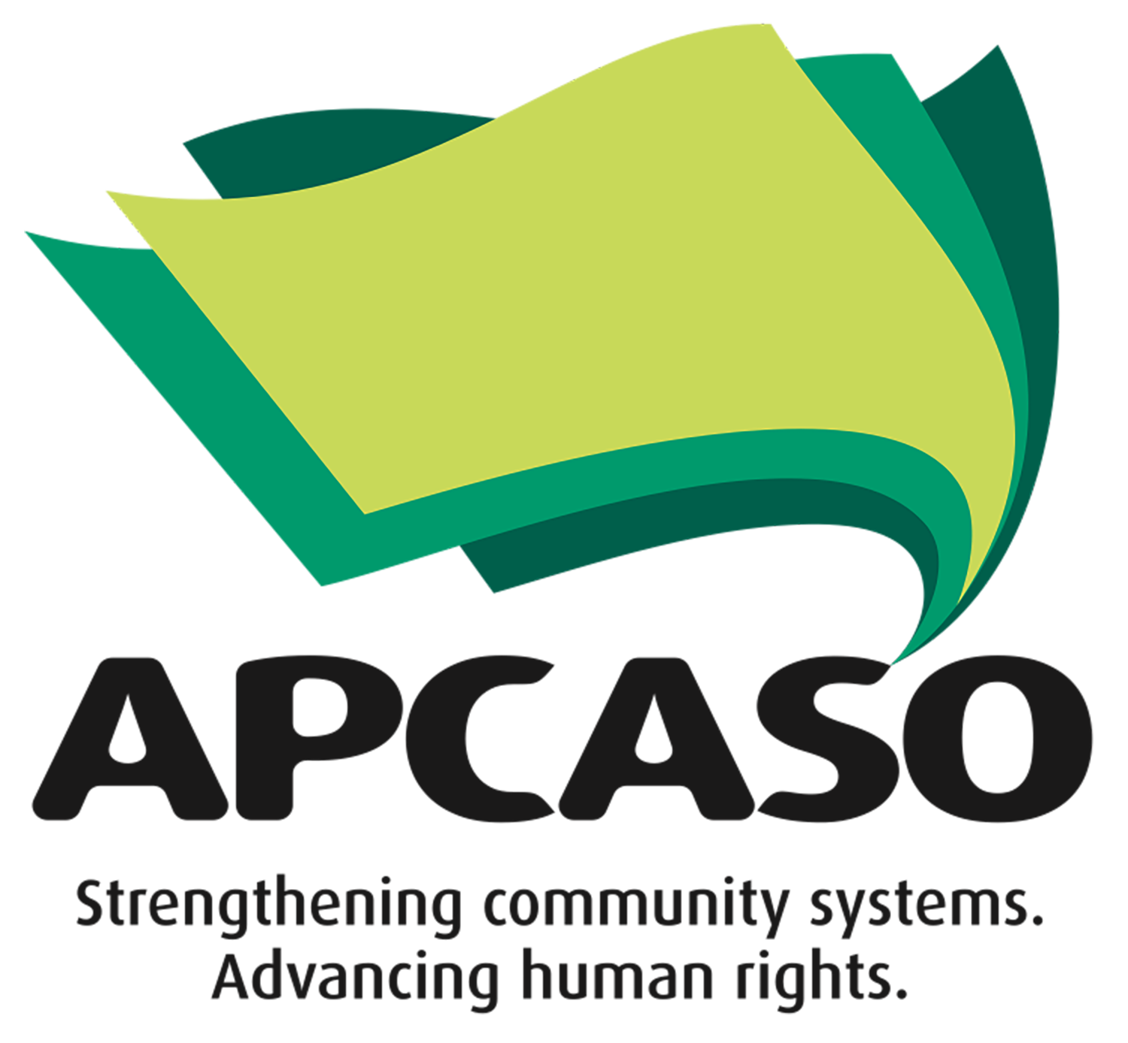
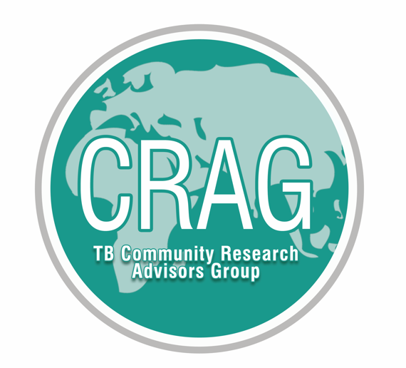
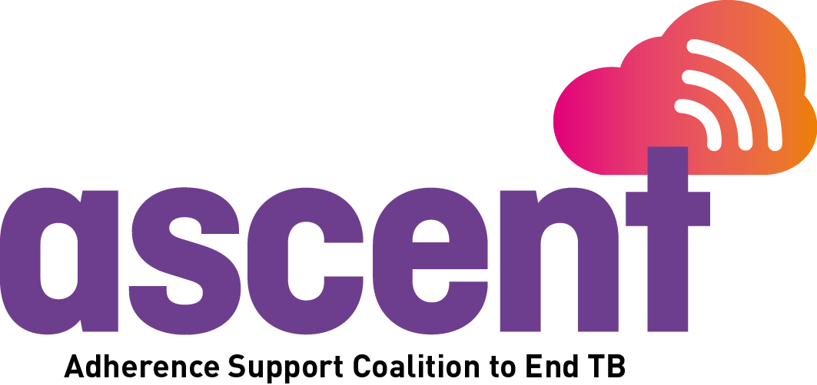
COMMUNITY ENGAGEMENT ALONG THE CONTINUUM FROM INNOVATION TO IMPACT
Notes:
TAG facilitates community engagement all along to research to policy continuum from innovation to implementation and impact. We work with community advisory boards to ensure that research and development efforts are aligned with the needs and priorities of TB-affected communities, and with cohorts of community and civil society organizations on policy advocacy and demand generation to promote access to evidence-based TB innovations and interventions.

Slide 4
COMMUNITY DEMAND & ACCOUNTABILITY FOR PERSON-CENTERED TB TREATMENT & CARE
TAG is leading community and civil society engagement (CCSE) under the ASCENT DR-TB project.
The CCSE component of ASCENT DR-TB will deploy a partnership model that pairs training in the science and practice of shorter regimens with competitive small grant funding, enabling community and civil society partners (CSOs) to design and implement projects at the national and sub-national levels.
Projects will advance advocacy to increase access to appropriate diagnosis and BPaL/M (and other WHO-recommended treatment regimens) within the context of a comprehensive package of patient-centered services and care.
The CCSE program will strengthen existing efforts through community awareness and demand creation for new diagnostic tools, treatment regimens, community engagement in care delivery, and treatment literacy.
The focal project countries include Ethiopia, Indonesia, Mozambique, Nigeria, South Africa, the Philippines, Ukraine, and Vietnam.

Slide 5
CCSE PROGRAM PROCESS & TIMELINES
Expression of interest
May 22, call published
June 6, deadline to apply
June 26, organizations notified of selection (27 CSOs)
Training part 1
July 17th, Introduction to ASCENT DR-TB Project, country assessments, and overview of community small grant program
July 25th, Introduction to Shorter Regimens for DR-TB
Proposal development, refinement and formalization
August, closed call for proposals
September, small grants awarded
Planning to award 5 - 8 small grants, US$25,000 - $40,000 each
Training part 2
Continuing education / deeper dives tailored to partner needs and small grant activities
In person workshop (Q1 2025)
Notes:
Next stage of the program will culminate in the opportunity for CSOs to apply for catalytic small grant funding to undertake community-led demand creation and policy advocacy to increase access to BPaL/M and other WHO-recommended treatment regimens for DR-TB.
Organizations that wish to apply for ASCENT DR-TB community small grants must first participate in two webinars. The webinars are designed to equip CSOs with the necessary tools to create a competitive small grant proposal.
Only organizations that have at least one representative participate in both webinars and complete short post-webinar assignments will be eligible to apply for small grant funding.
TAG will share the catalytic small grants program application documents with groups who complete the two webinars.
Note that we cannot fund all organizations who develop proposals and apply.
Proposals will be reviewed by a larger committee with 5–8 ultimately selected for funding.

Slide 6
SMALL GRANT SCORING CRITERIA
Alignment of project objectives with ASCENT DR-TB program goals and priorities
Linkages between technical assistance areas identified from country-level assessments and advocacy objectives, outcomes, and activities
Technical approach and feasibility of addressing the problem statement
Coherence of Theory of Change
Well-targeted objectives and outcomes
Clear linkage between objectives and outcomes with work plan activities
Coherent work plan with explicit activities, indicator data and milestones
Budget and cost-effectiveness
Sustainability Plan
Monitoring, evaluation, and learning plan
Notes:
Community activities under the small grants program are intended to help address challenges and barriers to patient-centered treatment and care for drug-resistant TB at national and sub-national levels. Small grant proposals will be evaluated based on their alignment with and linkages to priorities identified through country-level assesments and the corresponding ASCENT DR-TB technical assistance program objectives.

Slide 7
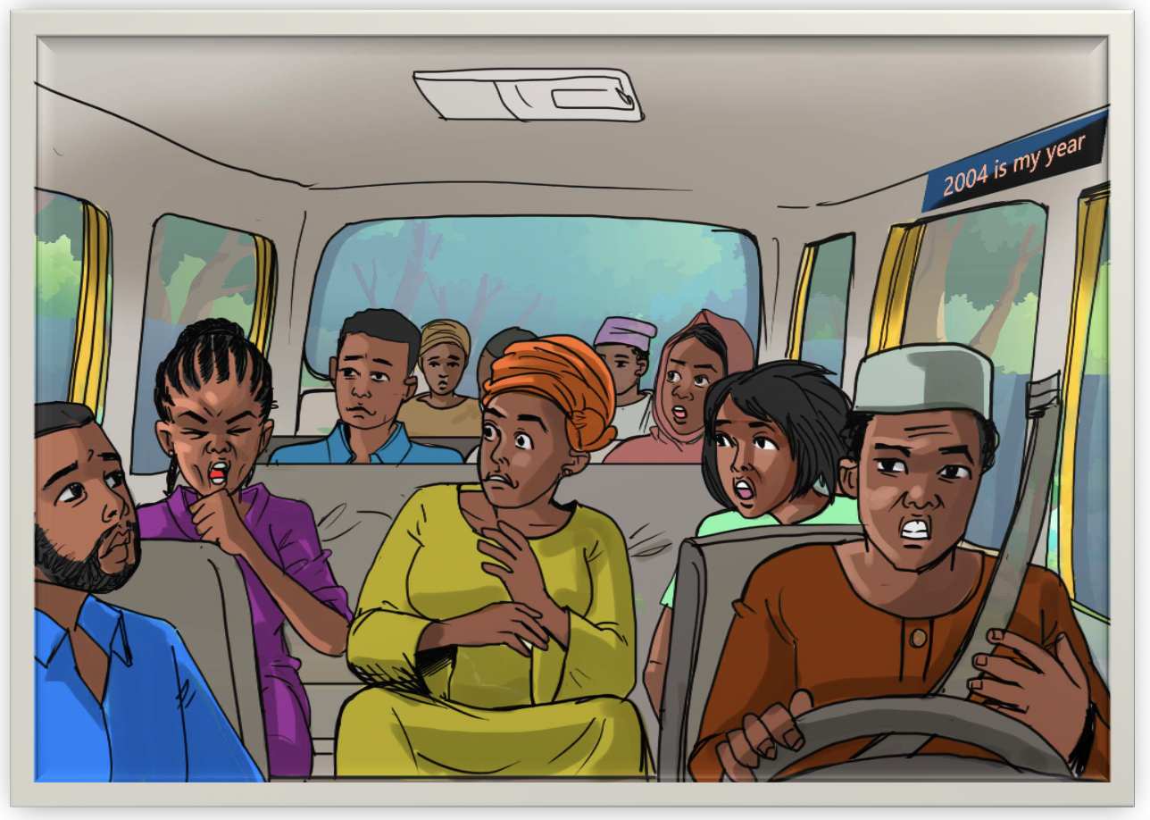
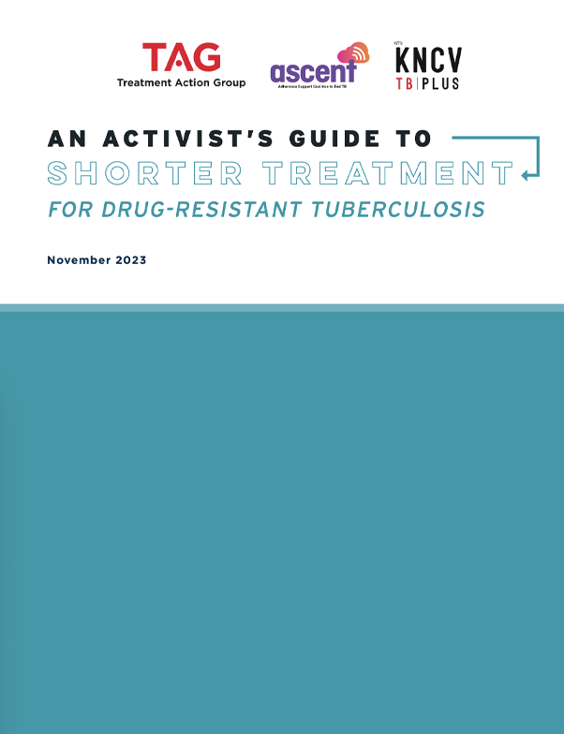
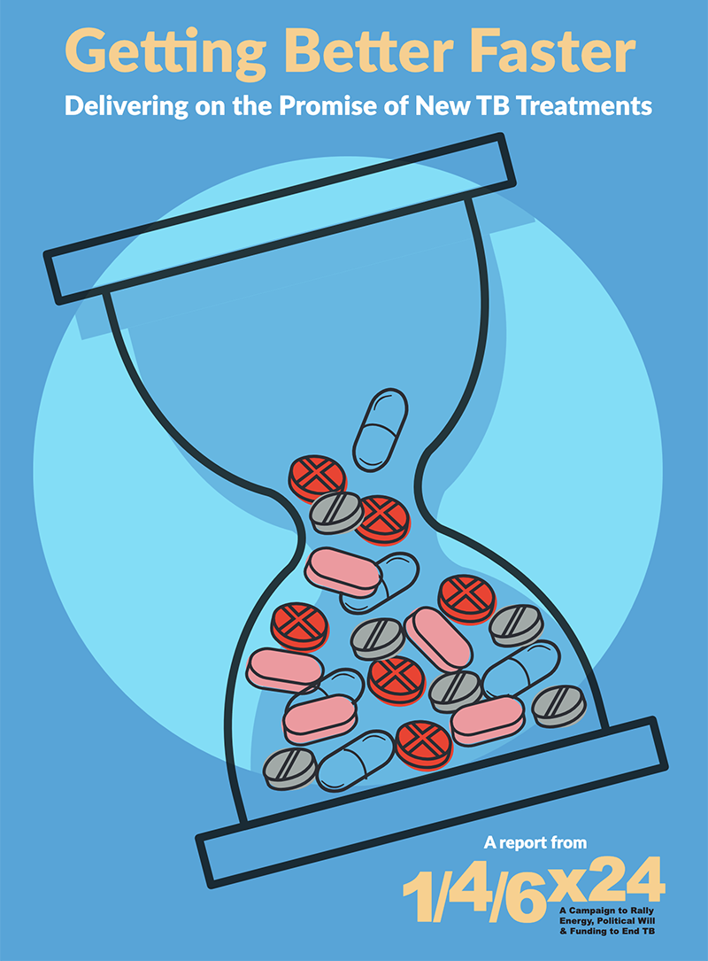
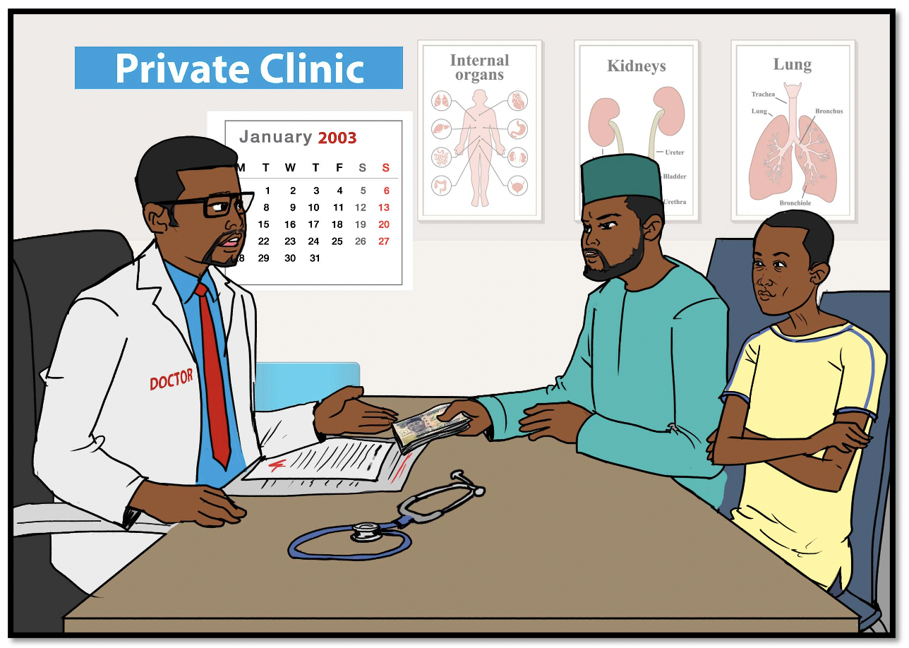
COMMUNITY & CIVIL SOCIETY TRAINING MATERIALS & OTHER RESOURCES
https://www.treatmentactiongroup.org/publication/an-activists-guide-to-shorter-treatment-for-drug-resistant-tuberculosis/.
https://www.treatmentactiongroup.org/publication/getting-better-faster-delivering-on-the-promise-of-new-tb-treatments-a-report-from-the-1-4-6x24-campaign/.
Community Engagement on TB through Storytelling
https://www.treatmentactiongroup.org/publication/community-engagement-on-tb-through-storytelling/.
Notes:
TAG will develop training and other materials and resources to build small grant partner knowledge and expertise and to support community engagement and advocacy activities.
Exiting resources include:
Story boards that can help build understanding, support discussions between members of affected communities and other stakeholders, and aid in the identification of important issues and potential solutions. Two storyboards on the TAG website describe the experiences of TB survivors from Nigeria. These individuals’ multi-year journeys through diagnosis, treatment, and cure illustrate the barriers people with TB and drug-resistant TB face, from misdiagnosis to lengthy and costly treatment to threats to employment. These storyboards can be used by community leaders and advocates in conjunction with other materials for TB awareness raising and to strengthen TB diagnosis and treatment literacy among affected communities.
An Activist’s Guide to Shorter Treatment for Drug-Resistant TB, which lays out what activists need to know about the new DR-TB treatment regimens, including an overview of findings from the trials that underpin WHO guidelines and important considerations for key populations affected by TB. It is intended to equip advocates with information they need to formulate arguments and push for universal implementation of the best available treatments.
And global campaigns and advocacy messages that can be adapted and used by civil society and community organizations working at regional, national, and sub-national levels.

Slide 8
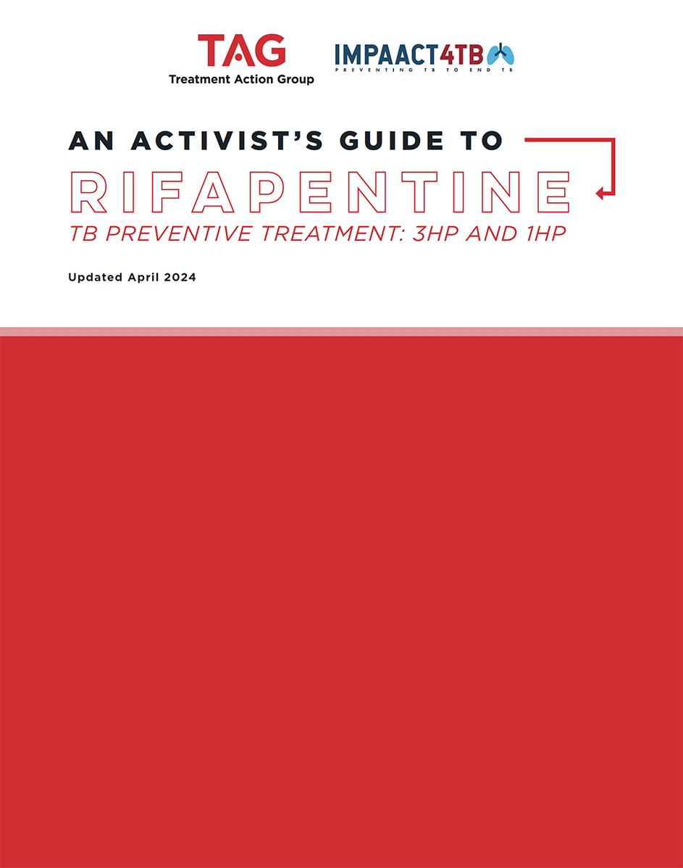
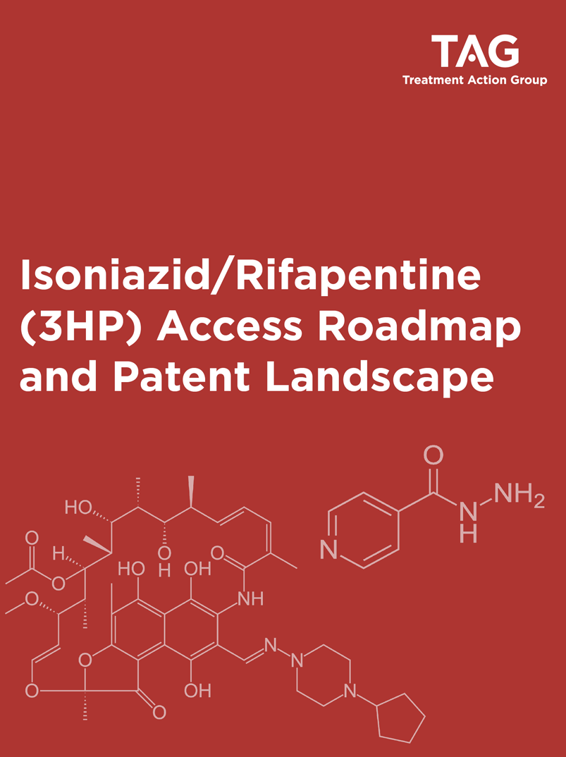
COMMUNITY & CIVIL SOCIETY PARTNERSHIPS
TAG leading on global, regional and national level advocacy.
Small grants for grassroots advocacy, demand creation, and community capacitation.
Disbursed >$400,000 to 25 organizations in 12 countries.
Community-led monitoring and communication tools.
Community TPT Treatment Literacy Toolkit and online training courses.
Coordinated global campaigns for 3HP uptake, access, and awareness. #RightToPreventTB
Community success stories.
Leading to faster:
update of national guidelines
inclusion of rifapentine in national EMLs
reviews of rifapentine products by SRAs/NRAs
scale-up via commitments to TPT and 3HP in PEPFAR COPs, Global Fund concept notes, national strategic plans
Notes:
The community and civil society engagement program under ASCENT DR-TB is modeled after a similar program that was focused on generating community demand for rifapentine-based TB preventive treatment under the Unitaid-funded IMPAACT4TB Project.
Similar to how the ASCENT DR-TB program will run, under IMPAACT4TB, TAG awarded small grants to community and civil society organizations and provided training and support for national and sub-national advocacy and other activities, and coordinated and connected small grant partners to advocacy opportunities at the regional and global levels.
Under the IMPAACT4TB Project, community partners developed and deployed community-led monitoring and communications tools and TB preventive treatment literacy toolkits and training courses; contributed to campaigns for TPT uptake, access and awareness; and shared community success stories.
These activities helped to accelerate national guidelines updates, regulatory reviews, and commitments to TPT in National Strategic Plans, PEPFAR COPs, and Global Fund Concept Notes.

Slide 9
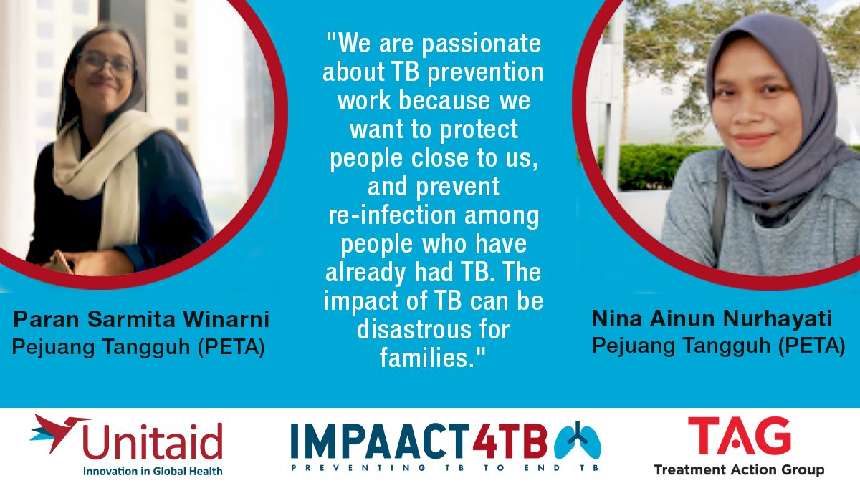
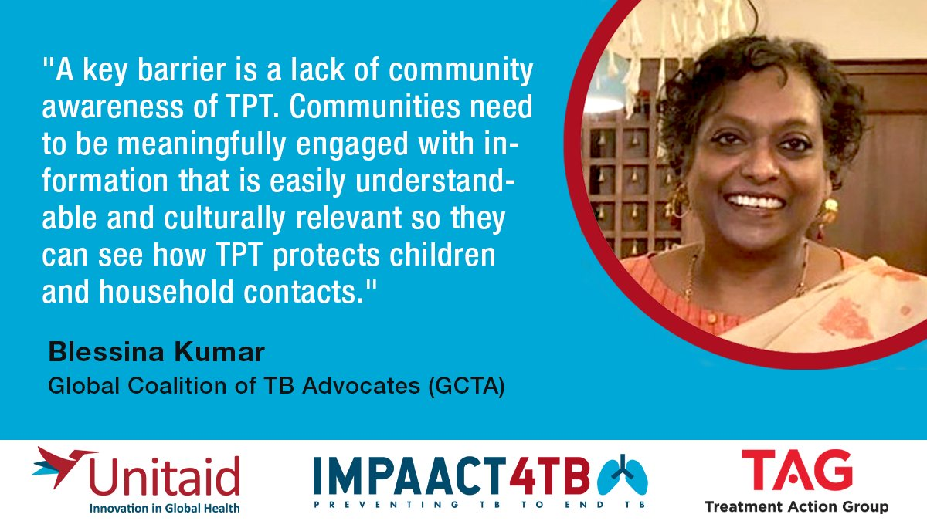
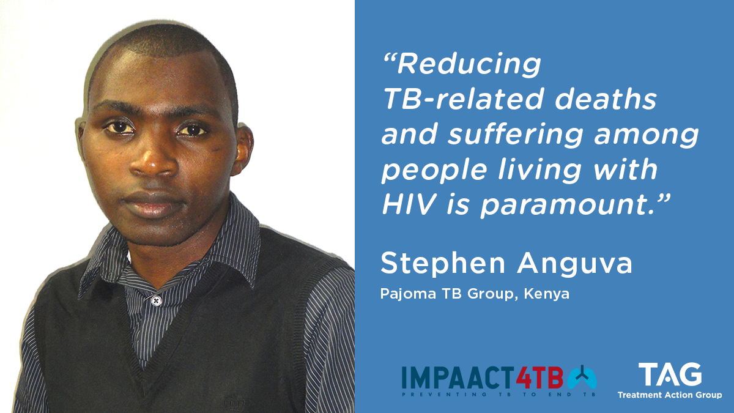
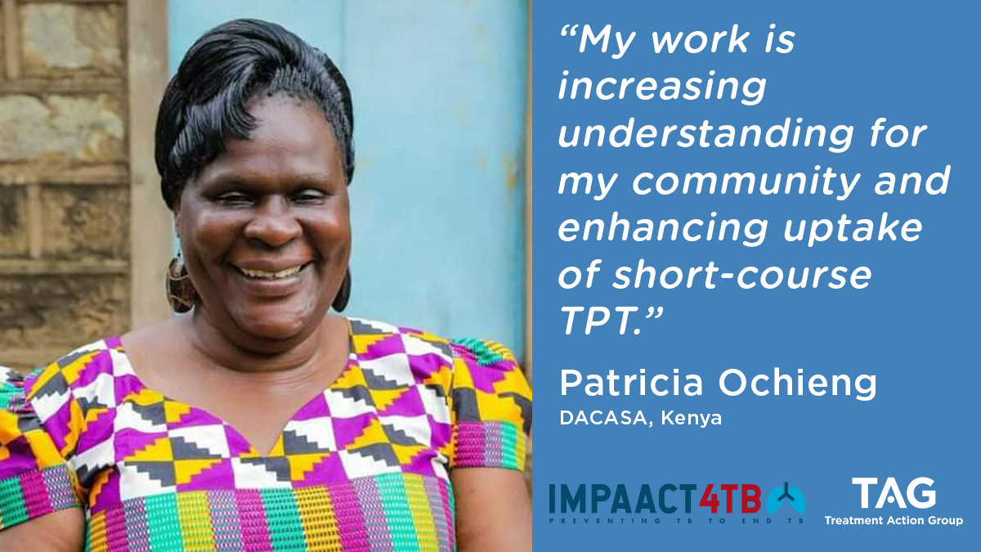
Created a cohort of advocates, trained in the science and practice of TB preventive treatment, who worked together and supported one another, and who remain committed to keep pushing the TB prevention agenda to ensure that everyone can enjoy their right to prevent TB.
Notes:
Arguably most importantly, the IMPAACT4TB community and civil society engagement and small grants program created a cohort of advocates, trained in the science and practice of TB preventive treatment, who worked together and supported one another, and who remain committed to keep pushing the TB prevention agenda to ensure that everyone can enjoy their right to prevent TB.
Something we hope to replicate for drug-resistant TB under the ASCENT DR-TB Project.

Slide 10
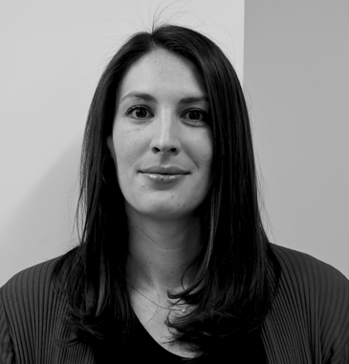
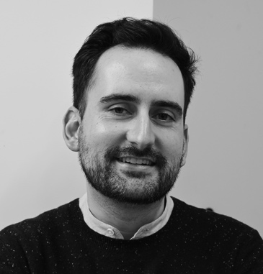
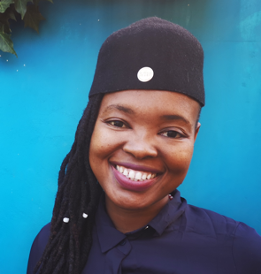
THANK YOU!
Lindsay McKenna TB Project Co-Director
Mike Frick TB Project Co-Director
Lynette Mabote
Consultant
Lindsay.McKenna@treatmentactiongroup.org
Mike.Frick@treatmentactiongroup.org
Lynette.Mabote@treatmentactiongroup.org
Notes:
We look forward to supporting community engagement and advocacy to increase access to appropriate diagnosis and treatment within the context of a comprehensive package of patient-centered services and care. Please don’t hesitate to get in touch for more information or to let us know how we can support your work.

